Slide 1
Robotics Workshop
For Mentorship Program

Slide 2
Workshop Outline :
Date | Event
24 March 2022 | Circuits & Arduino
25 March 2022 | Working Principle of Different Sensors
26 March 2022 | Line Follower Robot
27 March 2022 | Project Hunt
28 March 2022 | Project Hunt
29 March 2022 | Project Hunt

Slide 3
Team Alpha
Team Beta
Team Gama
Team Epsilon
Team Delta

Slide 4
Team Alpha
Shad & Joy Raj
Team Beta
Mowaz & Sajjad
Team Gama
Aditto & Nihal
Juniors (2019 Batch)
Team Delta
Afif & Razin
Team Epsilon
Pramit & Anwoy

Slide 5
Circuit
Arduino
Electricity
Voltage
Current
Resistance
Ohm’s Law
Resistance in Series and Parallel
Resistance Color Coding
Breadboard
About Arduino
Parts of the Arduino
Arduino IDE
Blinking LED with Arduino

Slide 6
Electricity
Static Electricity
Dynamic Electricity
Direct Current
Alternating Current

Slide 7
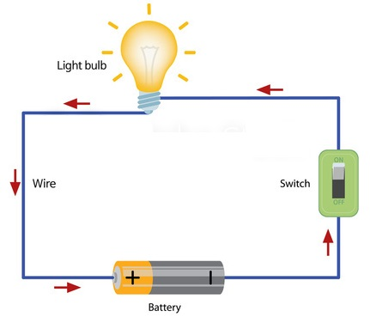

Slide 8
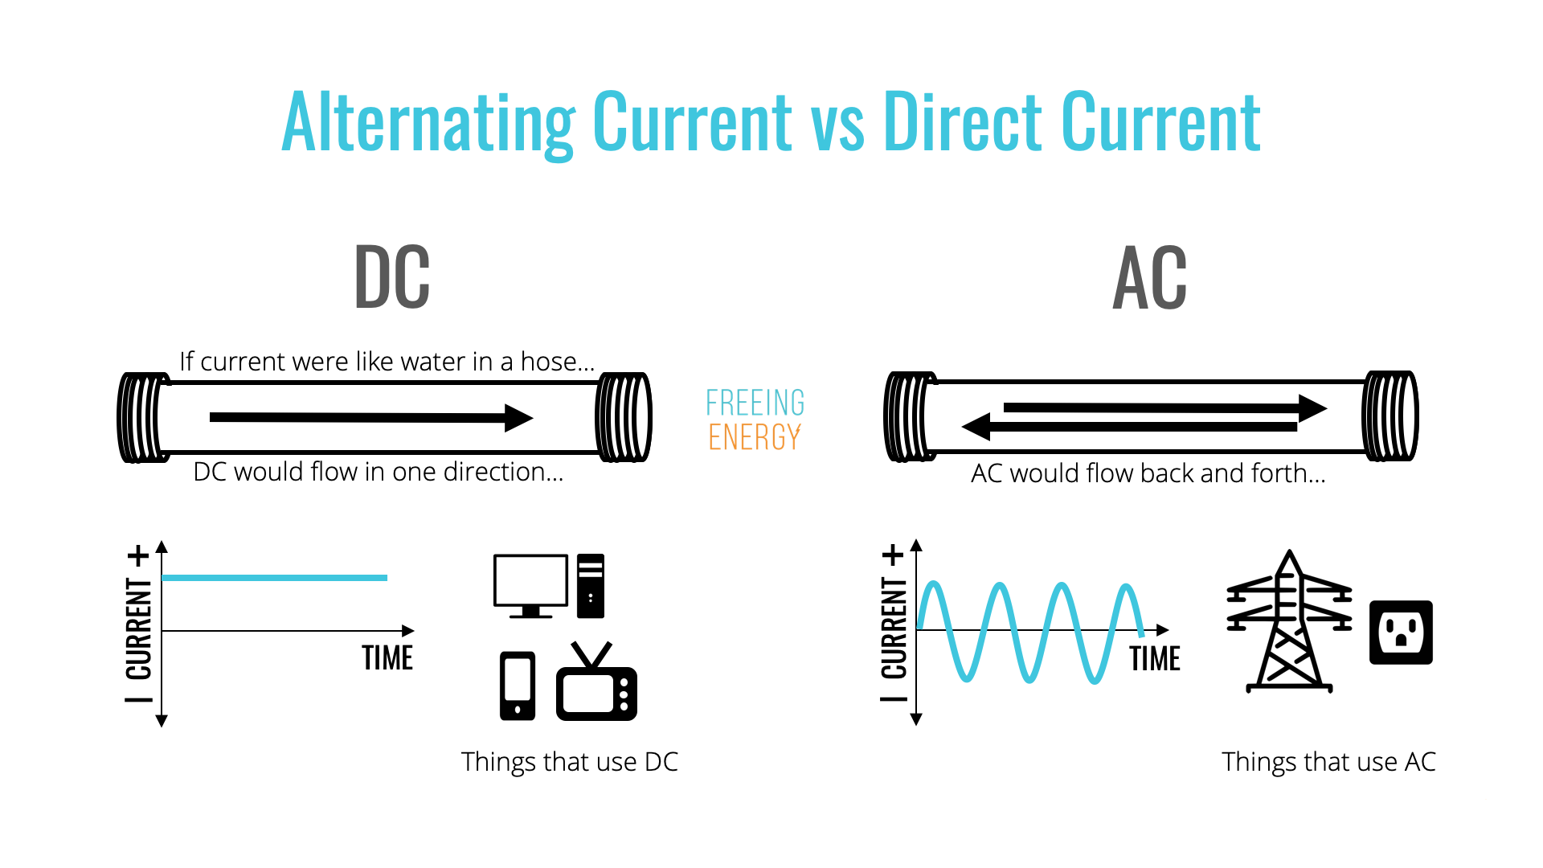
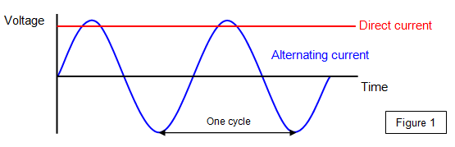

Slide 9
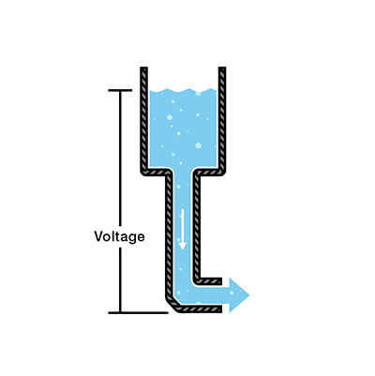
Voltage

Slide 10
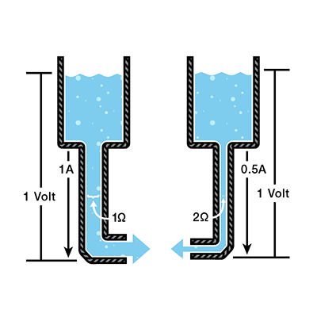
Current

Slide 11
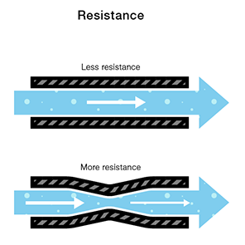

Slide 12
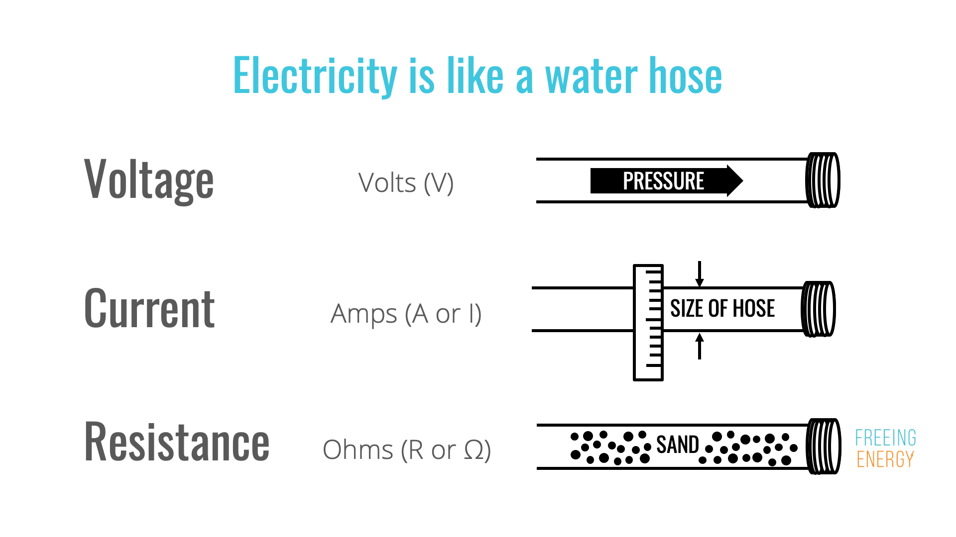

Slide 13
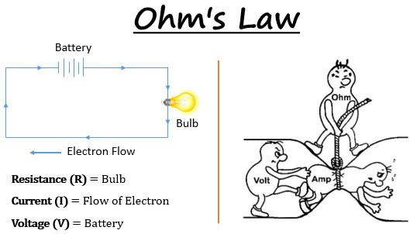

Slide 14
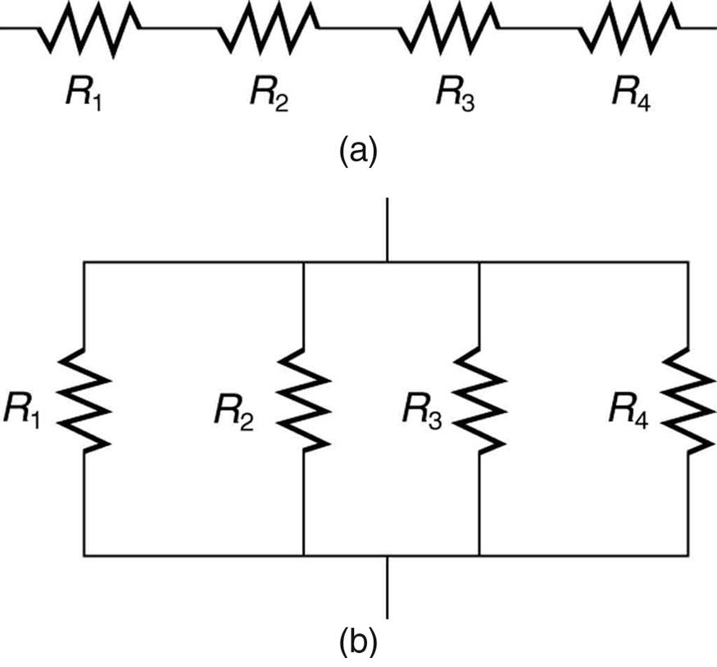

Slide 15
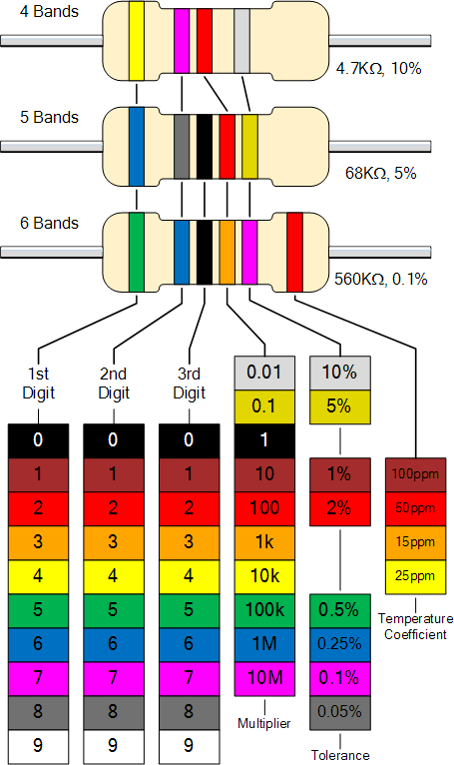

Slide 16
Arduino

Slide 17
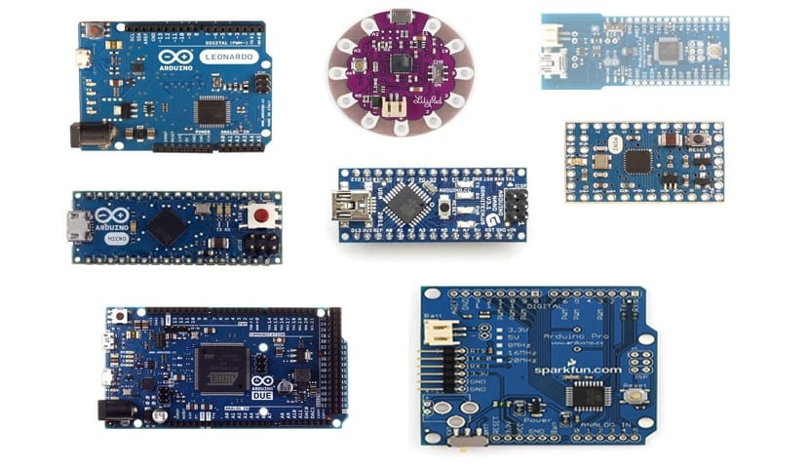

Slide 18
Arduino Specifications
Microcontroller : ATmega328
Operating Voltage : 5 V
Input Voltage (Recommended) : 7-12 V
Input Voltage (Limits) : 6-20 V
Digital I/O pins : 14 ( PWM pin = 6)
Analog Input Pins : 6
DC Current per I/O pin : 40mA
DC Current for 3.3V pin : 50mA
Flash Memory : 32 KB
Clock Speed : 16 MHz

Slide 19
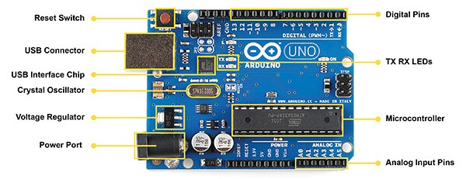

Slide 20
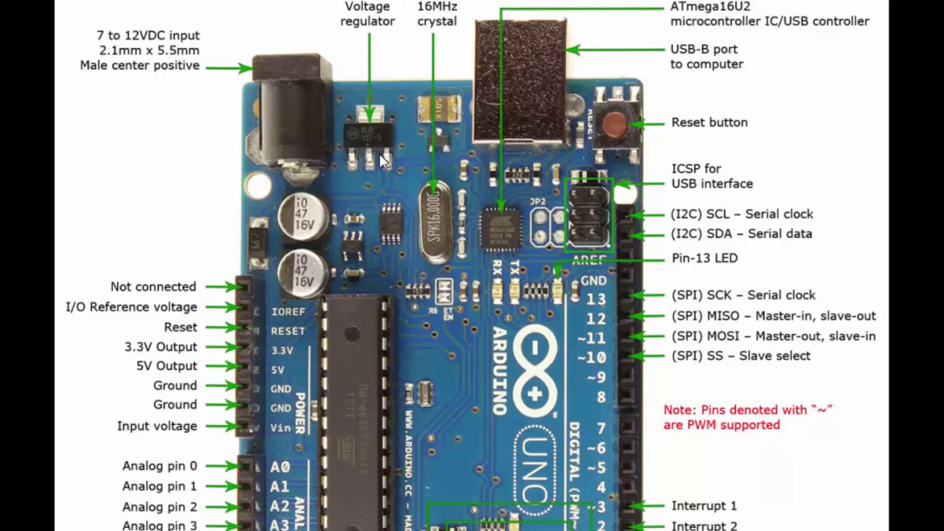

Slide 21
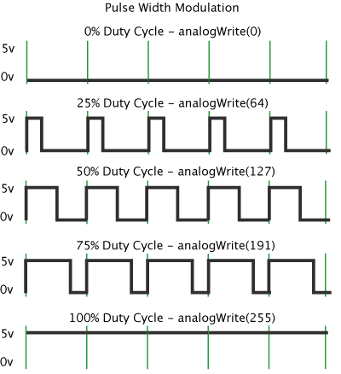

Slide 22
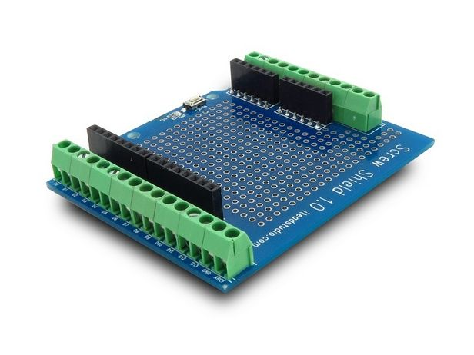
It is to let a shield know what voltage levels to expect on the IO pins from the underlying Arduino.
3.3V or 5V.
Shields are boards that can be plugged on top of the Arduino PCB extending its capabilities. The different shields follow the same philosophy as the original toolkit: they are easy to mount, and cheap to produce.

Slide 23
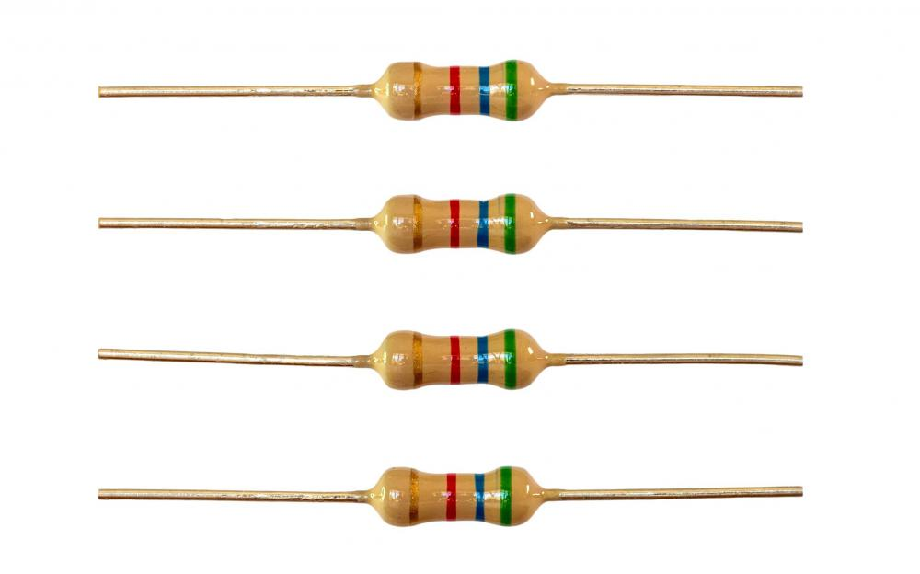
Always read resistors from left to right. - Resistors never start with a metallic band on the left. If you have a resistor with a gold or silver band on one end, you have a 5% or 10% tolerance resistor. Position the resistor with this band on the right side and again read your resistor from left to right.

Slide 24
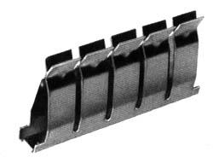
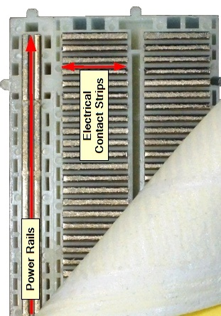
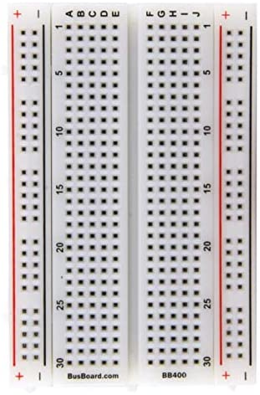
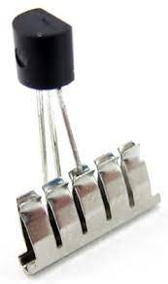

Slide 25
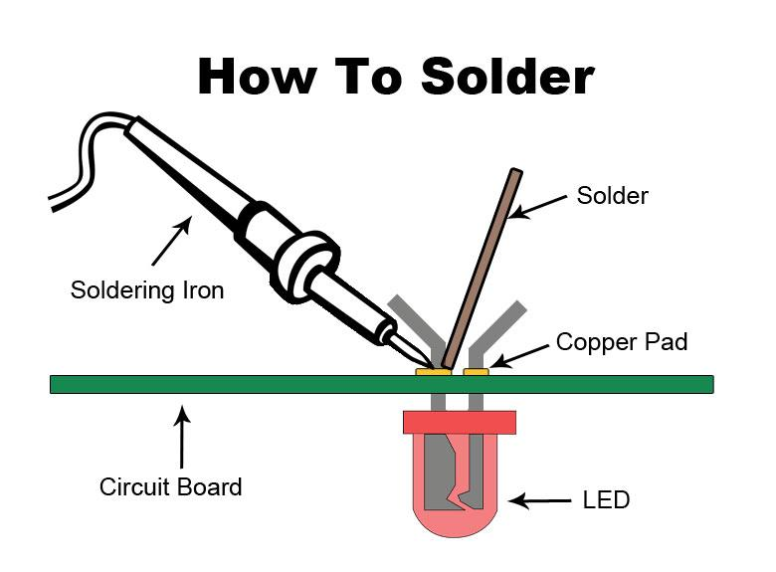
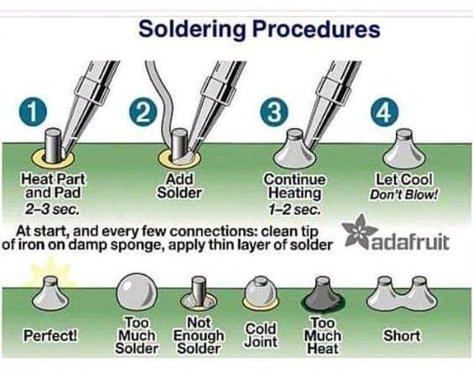

Slide 26
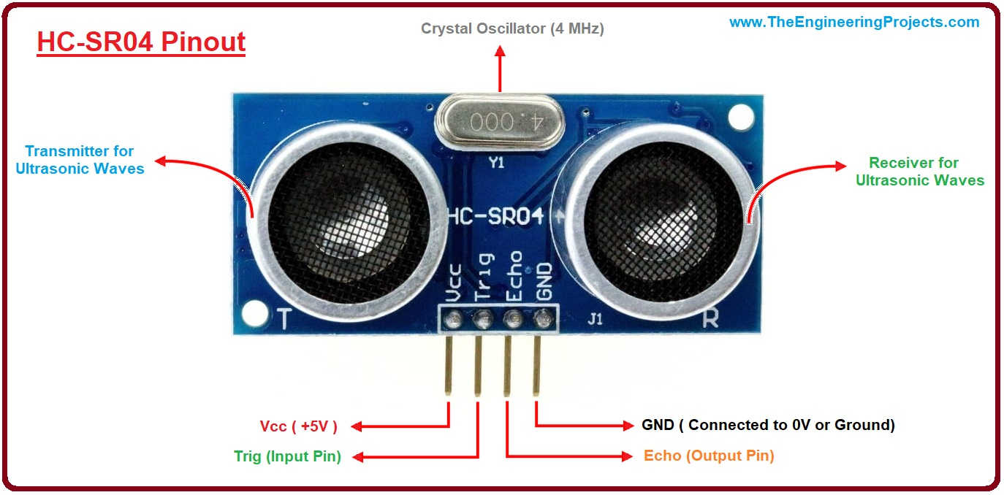

Slide 27
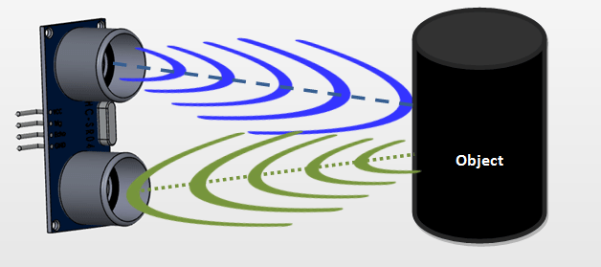
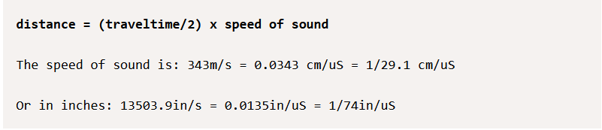

Slide 28
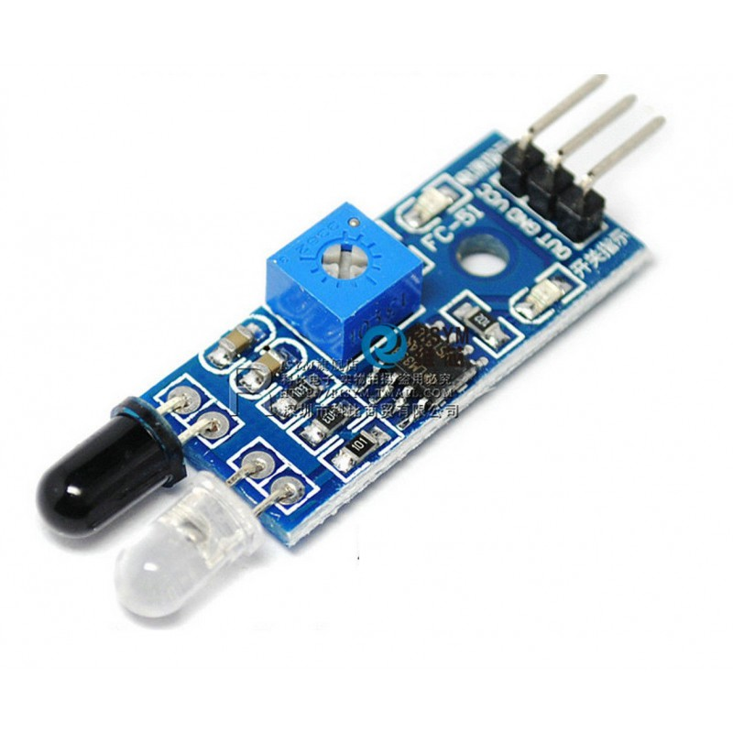
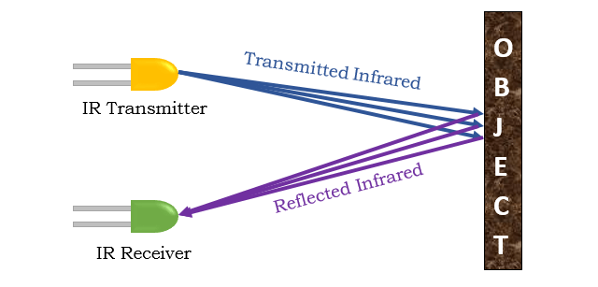

Slide 29
Programming

Slide 30
Structure of the code
Comments
Camel casing
Variables & Data Types
Operators
Control
Loops
Functions

Slide 31
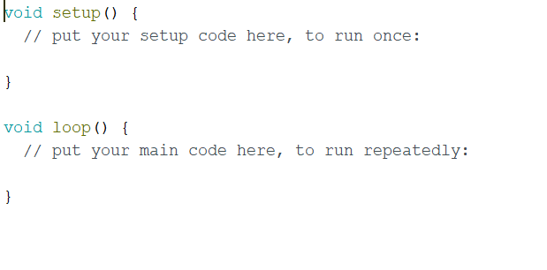

Slide 32
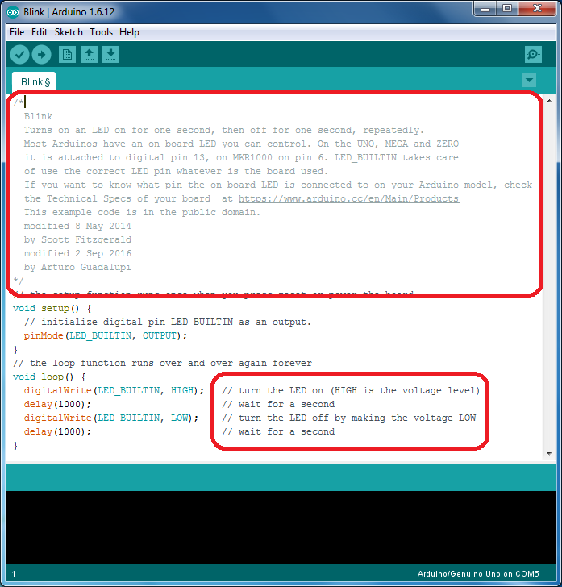

Slide 33

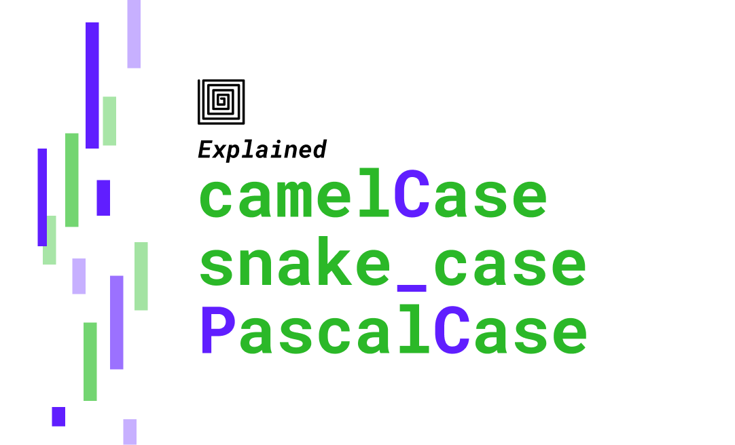

Slide 34
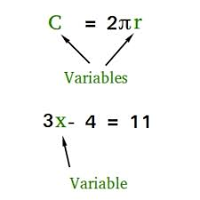

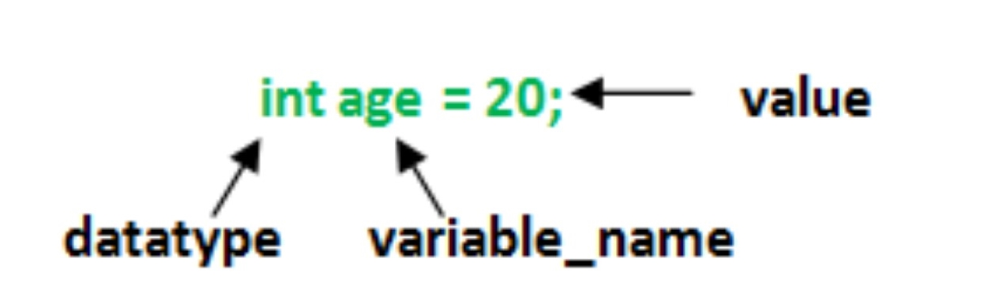

Slide 35
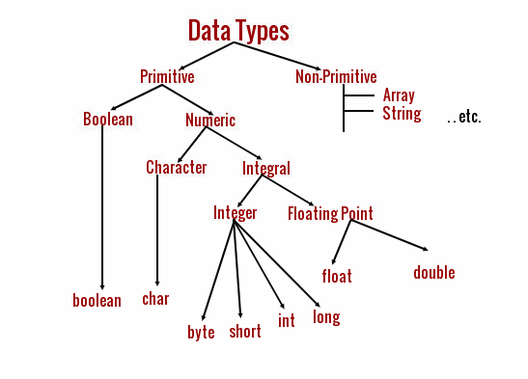

Slide 36
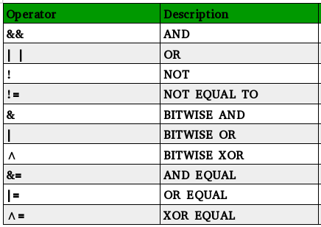

Slide 37
